Slide 1
Getting started with SharePoint Framework
SharePoint Framework Tools and Libraries

Slide 2
Agenda
Tools
Libraries
AMD & UMD Scripts
Q&A

Slide 3









Open source tooling
Build Process & Tooling
JavaScript Frameworks
Code Editors
Yeoman Templates Gulp-based Build Process NodeJS/NPM SystemJS Webpack SASS TypeScript
React Angular
Knockout
and more … your choice!
Visual Studio Code Atom Sublime
and more … your choice!

Slide 4


Server side tool comparison
IIS Express
C#
MSBuild
Project Templates

Slide 5
npm – Node Package Manager
> npm install typescript --save-dev
https://www.npmjs.com/
npm is a package manager for JavaScript
Similar ways as NuGet is for .NET framework managed code
Used with Node.js for local JavaScript development
Downloads 3rd party libraries used in your customizations
You can also share your own packages in npm for the benefit of others

Slide 6
Yeoman - Templates
> yo @Microsoft/sharepoint
http://yeoman.io
Scaffolding tool for development projects
Used to create SharePoint Framework templates on your development machine
Installed on your machine with npm

Slide 7
gulp – Your task and build manager
> gulp serve
http://gulpjs.com/
Provides automation for your build tasks
Platform-agnostic, simple solution, with strong ecosystem
Task manager similar in ways as MS Build is in Visual Studio projects

Slide 8
TypeScript – Typed JavaScript
> tsc
https://www.typescriptlang.org/
TypeScript is typed superset of JavaScript, which compiles to plain JavaScript
Development language for the base templates in SharePoint Framework
You can also integrate native JavaScript to SharePoint Framework customizations *
* No need to rewrite everything

Slide 9



Office UI Fabric
Fonts, icons
Colors
Front-end experiences for SharePoint
Powers Microsoft’s own experiences
Available out-of-the-box
Design web parts seamlessly
Office UI Fabric React includes a rich set of reusable controls
Components
http://dev.office.com/fabric
Notes:
Built into the SharePoint mobile apps

Slide 10
DEMO
Tooling in practice – Yeoman, Gulp, Webpack, TypeScript, Office UI fabric etc.

Slide 11
Asyncronous Module Definition (AMD) Scripts
Typically used in browser based apps
JavaScript specification to load code modules and dependencies asynchronously
Increases performance by loading smaller JavaScript files, as needed
Dependencies must load before module execution, this can reduce errors
Allows developers to create smaller JavaScript files
May be concatenated and minified
RequireJS - http://requirejs.org/
Module 1
Module 3
Module 5
Module 2
Module 4
Module 6

Slide 12
Universal Module Definition (UMD) Scripts
Used to create modules that are capable of working and being loaded from anywhere
Client (web page)
<SCRIPT> tags used to import modules
Server (node.js)
CommonJS (AMD loader) used to import modules
Other
https://github.com/umdjs/umd

Slide 13
AMD & UMD Examples
AMD
jQuery 1.7
Dojo 1.7
EmbedJS
Ender-associated modules like bonzo, qwery, bean and domready
Used by Firebug 1.8+
The simplified CommonJS wrapper can be used in Jetpack/Add-on SDK for Firefox
UMD
jqueryPlugin.js - Defines a jQuery plugin that works with AMD and browser globals.
nodeAdapter.js - Best for when using AMD style but want it to work in Node without a helper library that sets up AMD.
commonjsAdapter.js - Similar to nodeAdapter.js, but compatible with more CommonJS runtimes, and if you want to define a circular dependency.

Slide 14
AMD/UMD & Non-AMD Usage In SPFx
AMD/UMD
Specify the URL where the script should be downloaded from
Dependencies to other scripts are handled already inside the script's module construct
Non-AMD
Specify the URL where the script should be downloaded from
Specify the name of the variable with which the script will be registered in the global scope
If the non-AMD script depends on other scripts, they should be listed as dependencies
"jquery": "https://code.jquery.com/jquery-2.2.4.js"
"angular": { "path": "https://cdnjs.cloudflare.com/ajax/libs/angular.js/1.5.8/angular.min.js",
"globalName": "angular" }

Slide 15
Summary
Tools
Libraries
AMD & UMD Scripts
Q&A

Slide 16
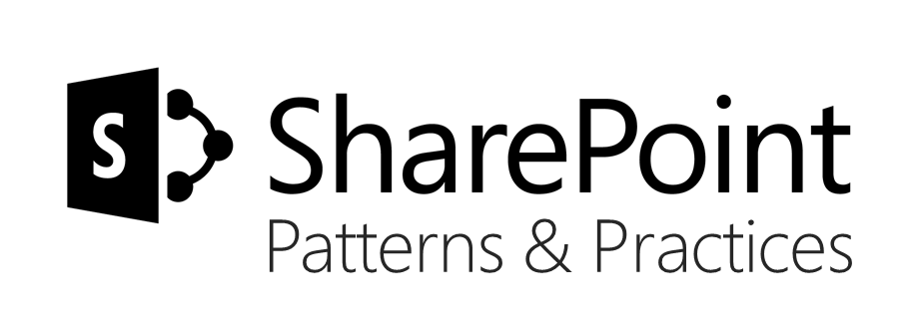
Sharing is caring…
Code samples and solutions
Reusable components
Guidance documentation
Monthly community calls
SharePoint Framework
SharePoint add-ins
Microsoft Graph
Office 365 APIs
http://aka.ms/SharePointPnP

Slide 17

Q&A

Slide 18


